Slide 1
Search in Android
John Brink and Minda Carpenter
Notes:
Minda

Slide 2
What is Search?
Lets you sort through large amounts of data easily
Only useful when you have an idea of you’re looking for
Can be used locally or on the internet
Focus on local search
Notes:
Don’t spend too long on this part
The question “What is search?” sounds obvious, but you may overlook search when building an app that really needs it.
Give some examples: Email, contacts, documents, apps, music
Focusing on local search, not web search

Slide 3
Why Use Search?
So your users don’t have to sift through massive amounts of information
Likely to be necessary in any app that can store or view an arbitrary amount of data
Used when the user knows what he’s looking for
Notes:
Also covers “when do I need search?”

Slide 4
Issues in Search
Speed: Search should be faster than browsing
Should be intuitive - user should immediately know what the app is looking for

Slide 5
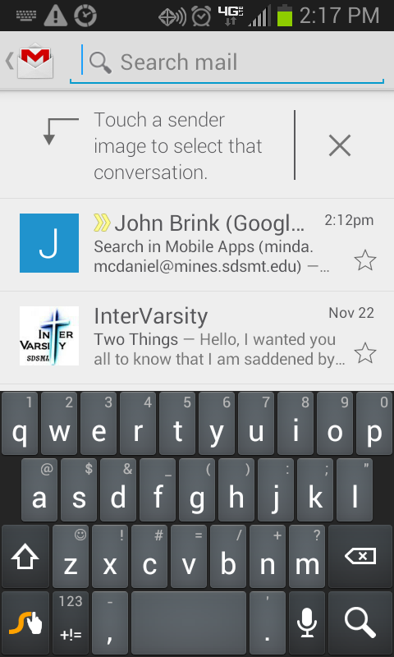
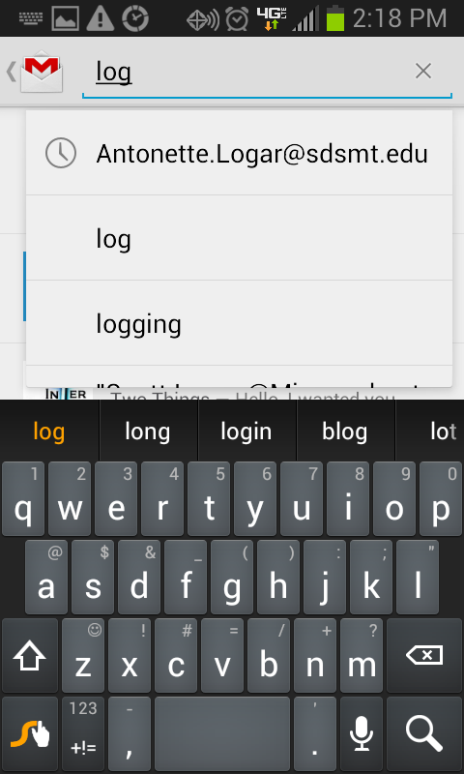
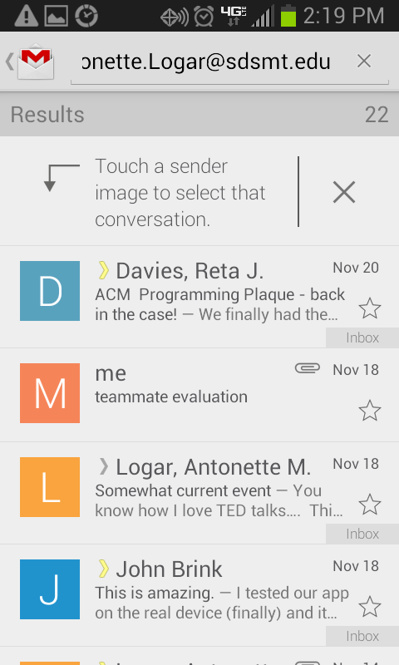
Example: Gmail for Android

Slide 6
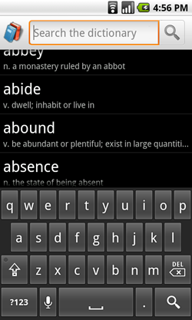
Dialogue vs Widget
SearchDialogue: controlled by the system; always placed at the top of the activity
SearchWidget: create and place however you want (requires API level 11)
Our app uses the SearchDialogue
Notes:
Minda

Slide 7
How to Search
Create the Searchable
Add intents to manifest
Declare the searchable activity
Add app-specific implementation
Call onSearchRequested()
Notes:
John
Show in Eclipse and demonstrate

Slide 8
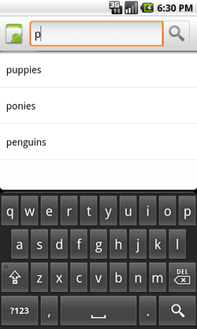
Search Suggestions
Create a Searchable Activity as before
Create a content provider that extends SearchRecentSuggestionsProvider and declare it in your application manifest
Save queries to your content provider every time you search
Notes:
John

Slide 9
Conclusion
Search is a very helpful feature
It is relatively easy to implement (depending on your model)
Android search is very flexible
Works with the MVC implementation
Notes:
Minda or both
Sum up everything up to this
Took about 1 hour to add to our Address Book

Slide 10
References
Android Developer Documents http://developer.android.com/guide/topics/search/index.html
Mednieks, Zigurd, Laird Dornin, G. Blake Meike, and Masumi Nakamura. Programming Android. Second ed. Sebastopol: O'Reilly, CA. 395-405. Print.

Slide 11
Questions?

